Slide 1


Slide 2

PRESENTATION BY: GROUP 4
Title : THE EFFECT OF DOMESTIC VIOLENCE ON WOMEN MENTAL HEALTH.
DATE: 20 AGUST 2024

Slide 3
Objective: To analyze the prevalence of domestic violence (DV) exposure among women and its relationship with safety perceptions,well-beging,and other demographic factors.
INTRODUCTION
ANALYTICAL QUESTIONS:
What percentage of women have experienced or know someone who has experienced domestic violence?
Is there a significant relationship between DV exposure and feelings of safety?
How do different types of DV impact feelings of safety and well-being?
Does conflict frequency mediate the relationship between DV and safety perceptions?
How does seeking help moderate the effects of DV on safety and mobility?
Are women with disabilities at higher risk of experiencing DV and lower well-being scores?
Do women exposed to domestic violence report higher levels of mental health strain indicators such as food insecurity (rA12) and feeling unsafe walking alone during the day/night

Slide 4
Prevalence of Domestic Violence Exposure
Overall Prevalence:57.98% of women reported experiencing or knowing someone who has experienced DV.
Breakdown by Age Group:18-29 years: 61.5%
30-39 years: 60.8%
40-49 years: 59.1%
50-59 years: 56.4%
60 years and older: 44.0%
Statistical Significance: Chi-squared tests indicate significant differences across age groups (p < 2.2e-16).

Slide 5
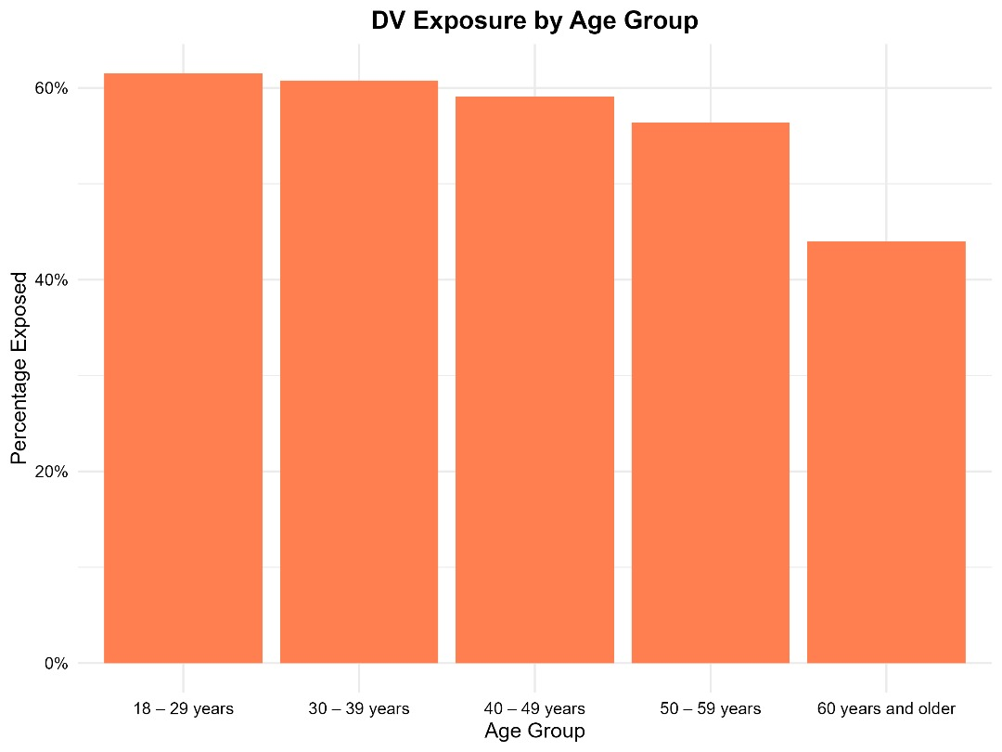
DOMESTIC VIOLENCE EXPOSURE BY AGE GROUP
The prevalence of DV exposure is highest among younger women aged 18-29 years (61.5%) and gradually decreases with age, reaching a low of 44.0% in women aged 60 years and older. This suggests that younger women may be more vulnerable or more likely to report such experiences.

Slide 6
ANALYSIS QUESTION 1(CONTENUE)
Breakdown by Marital Status:
Living with Partner: 58.1%
Separated/Divorced: 62.3%
Single: 57.7%
Widowed: 55.0%
Breakdown by Education Level:
College: 55.2%
Completed Primary: 61.6%
Completed Secondary: 59.8%
Less than Primary: 70.5%
Post College: 68.9%
Technical/Vocational: 46.3%

Slide 7
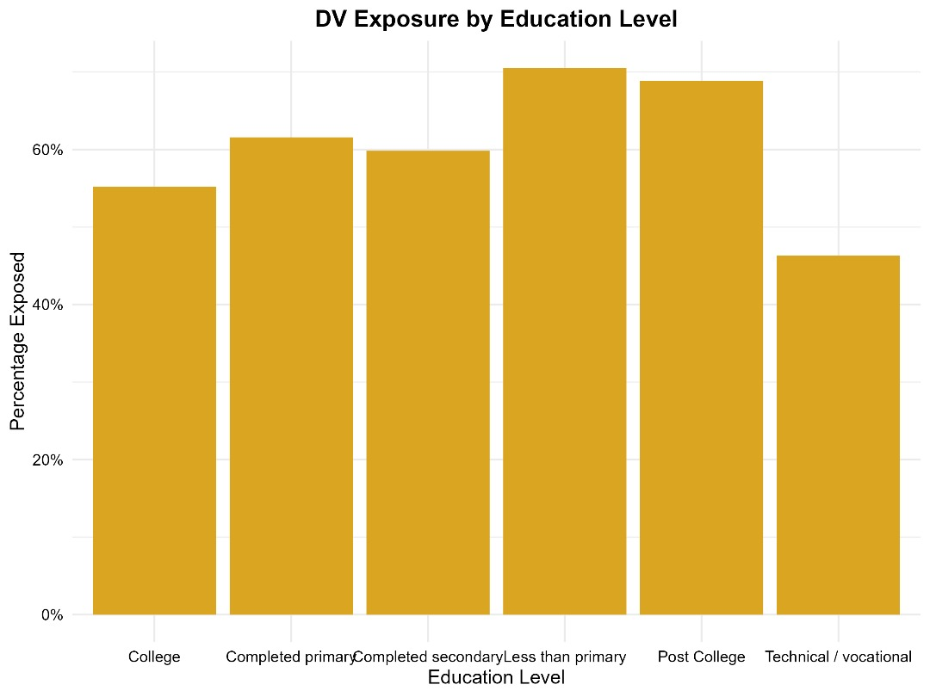
DV BY EDUCATIONAL LEVEL
The data shows a varied prevalence of DV exposure based on education level. Women with less than primary education report the highest prevalence (70.5%), while those with a technical/vocational background report the lowest (46.3%). This suggests that education may be a factor influencing the likelihood of experiencing or knowing someone who has experienced domestic violence.

Slide 8
Impact of Domestic Violence on Safety Perceptions
Mean Unsafe Score:
DV Exposure: 0.450
No DV Exposure: 0.326
Difference: 0.124 (p < 2.2e-16)
Effect Size: Hedges' g = -0.61 (medium effect)
Conclusion: Women exposed to DV report significantly higher feelings of unsafety.

Slide 9
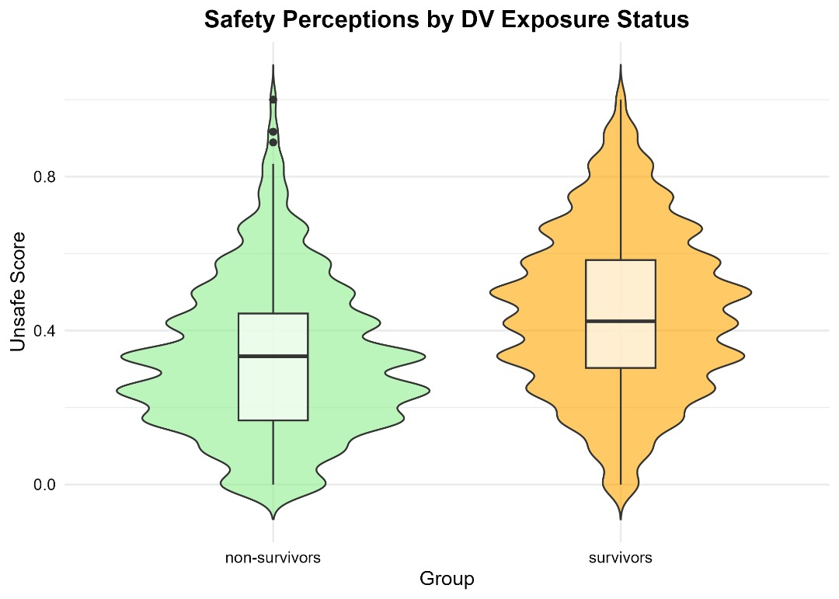
DOMESTIC VIOLENCE ON SAFETY PERCEPTION

Slide 10
Types of Domestic Violence and Their Effects
MANOVA Results:
Significant differences in Unsafe and Well-Being Scores based on DV type (p < 2.2e-16).
Post-hoc Tests:
Pairwise comparisons reveal significant differences between various types of DV (e.g., Physical vs. Verbal).
Conclusion:
Different types of DV have differential impacts on safety and well-being.

Slide 11
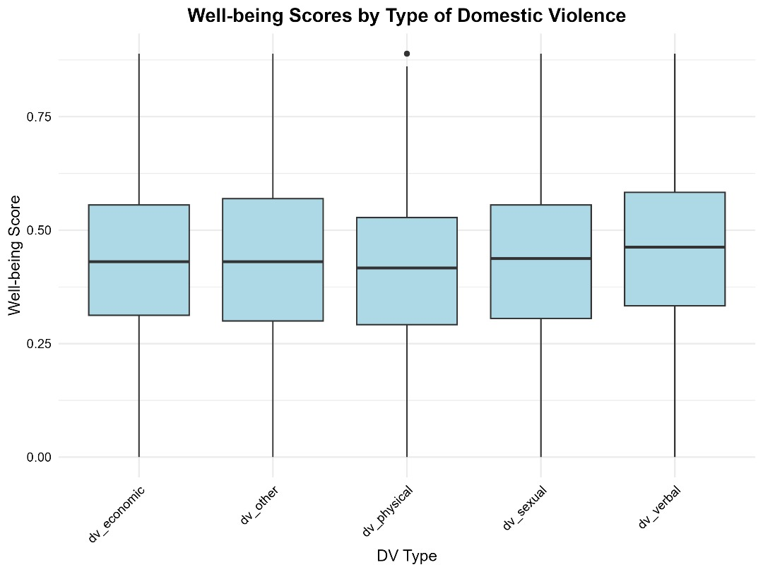
WELL-BEING SCORES BY TYPE OF DOMESTIC VIOLENCE

Slide 12
Mediation Analysis
Mediation Effect of Conflict Frequency:
Approximately 13% of the impact of DV exposure on safety perceptions is mediated by conflict frequency.
Direct Effect: 87% of the impact is direct.
Conclusion:
Conflict frequency plays a significant role in the relationship between DV exposure and feelings of safety.

Slide 13
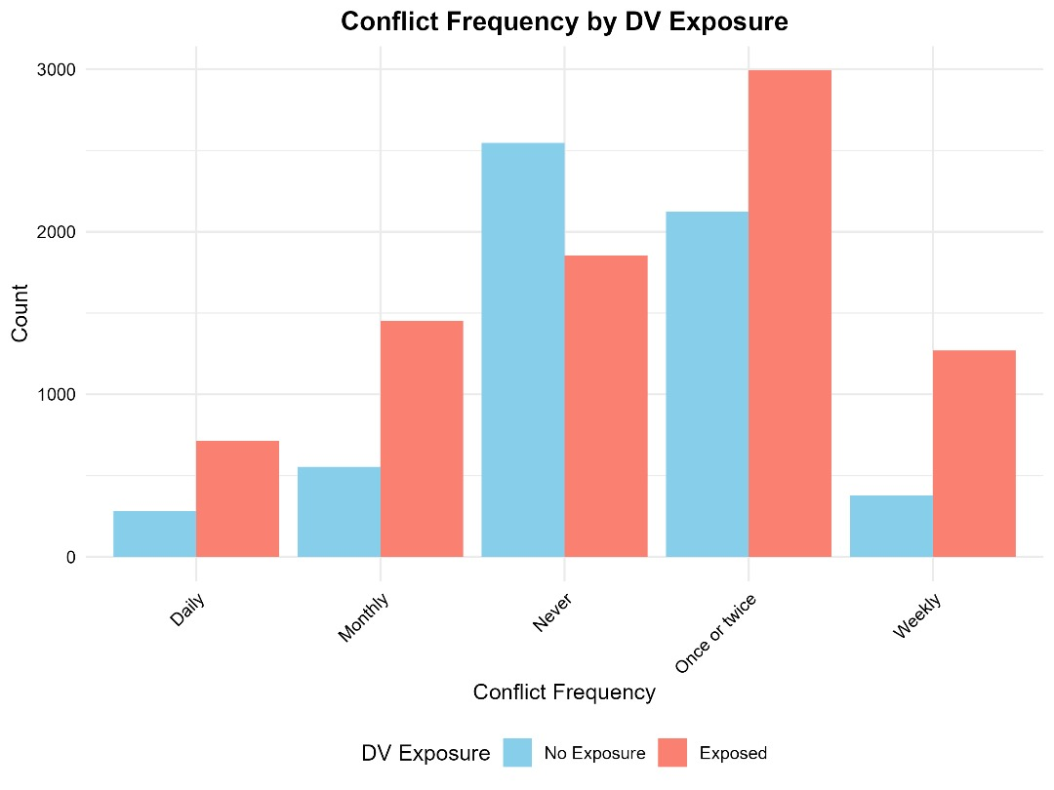
CONFLICT FREQUENCE BY DOMESTIC VIOLENCE EXPOSURE

Slide 14
Moderation Analysis
Help-Seeking Behavior:
Logistic regression indicates no significant moderation effect of help type on safety perceptions.
Linear regression shows a slight negative effect of informal help on mobility (p = 0.00834).
Conclusion:
Seeking help does not significantly moderate the effects of DV on safety perceptions.

Slide 15
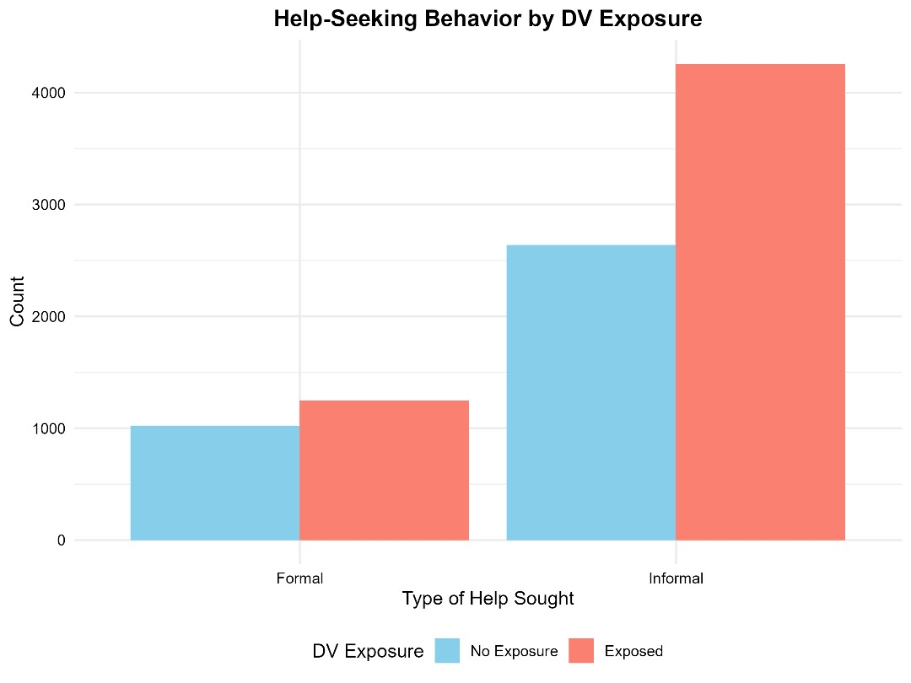
HELP-SEEKING BEHAVOR BY DOMESTIC VIOLENCE EXPOSURE

Slide 16
Disability Status and Domestic Violence
Chi-Squared Test Results:
Significant association between disability status and DV exposure (p = 3.468e-05).
Logistic Regression:
Odds Ratio for disability status: 1.197 (95% CI: [1.106, 1.296]).
Well-Being Scores:
Non-disabled: Mean = 0.643
Disabled: Mean = 0.546
Conclusion:
Women with disabilities are at higher risk for DV and report lower well-being scores.

Slide 17
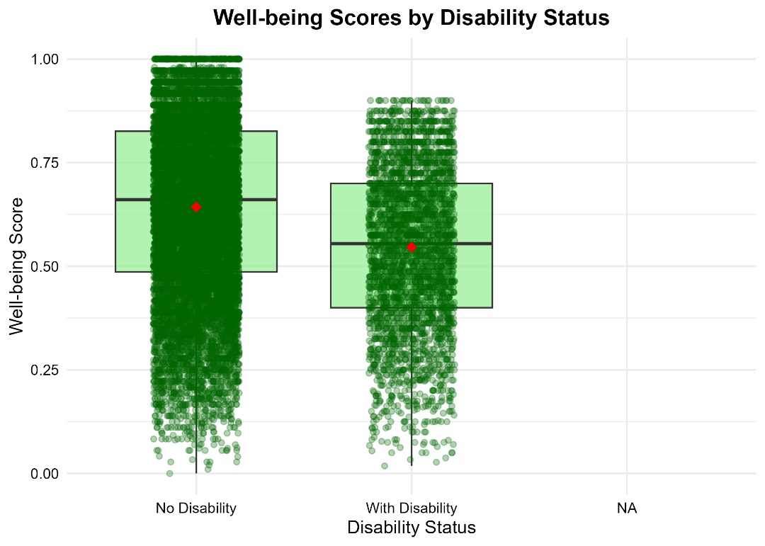
WELL-BEING SCORES BY DISABILITY STATUS

Slide 18
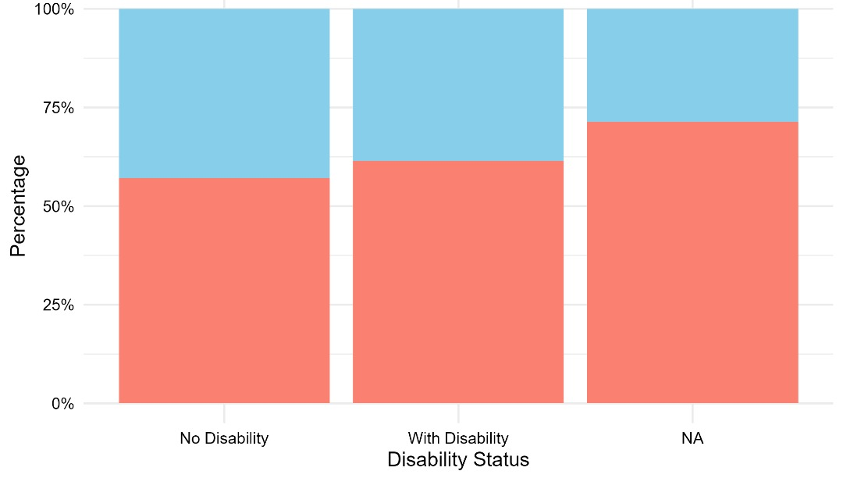
DV EXPOSURE BY DISABILITY STATUS

Slide 19
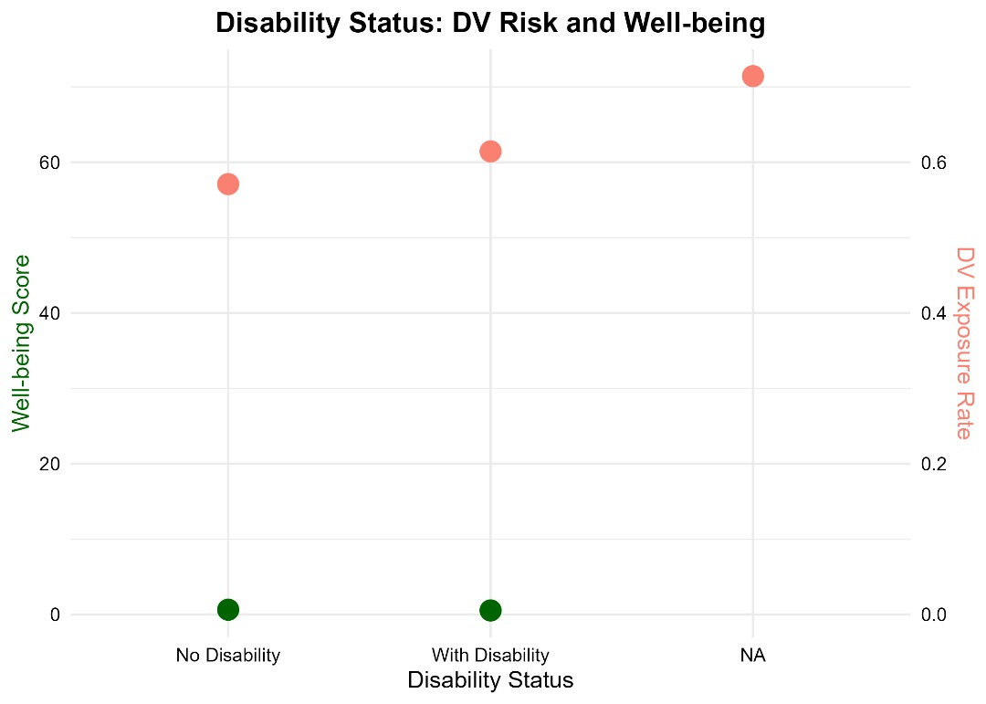
DISABILITY STATUS: DV RISK AND WELL-BEING

Slide 20
Food Insecurity and Mental Health Strain
Higher Rates of Food Insecurity:
Women who have experienced domestic violence report food insufficiency at rates of 35.7% for recent abuse and 26.5% for past abuse.
This indicates a clear link between domestic violence and food insecurity, suggesting that survivors face significant challenges in accessing adequate nutrition.
Impact on Mental Health:
The stress associated with food insecurity can exacerbate mental health issues, leading to increased anxiety and depression among survivors of domestic violence.
The relationship between food insecurity and mental health strain is complex, with many women reporting that their experiences of violence contribute to their food-related challenges.

Slide 21
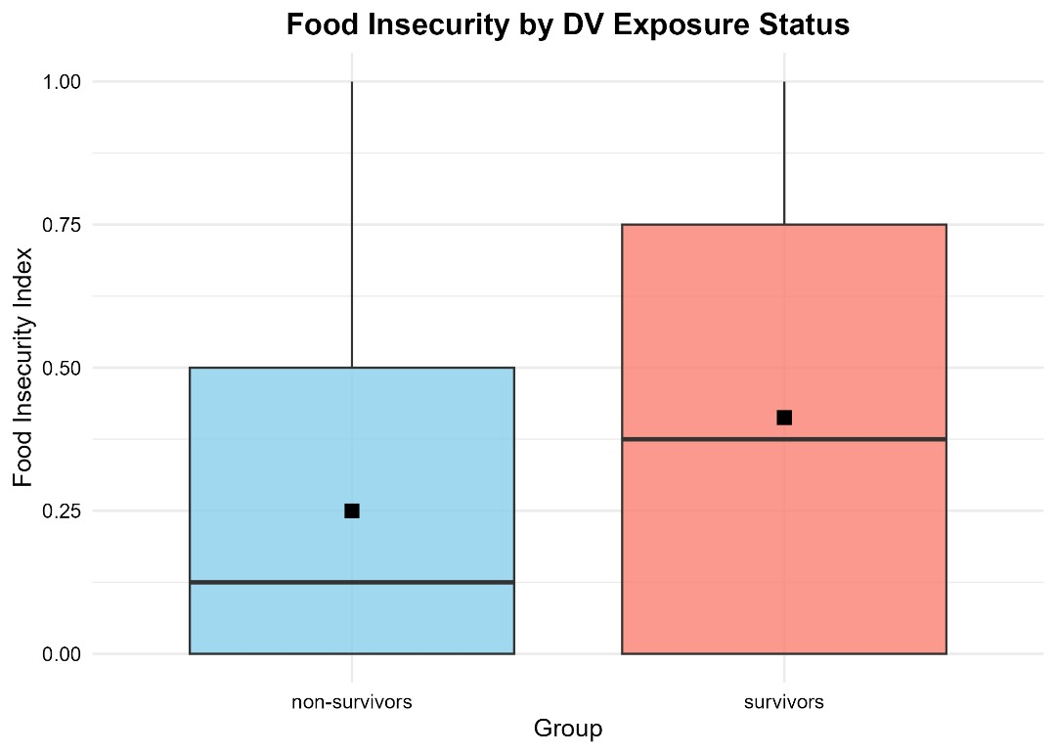
FOOD INSECURITY BY DOMESTIC VIOLENCE EXPOSURE STATUS

Slide 22
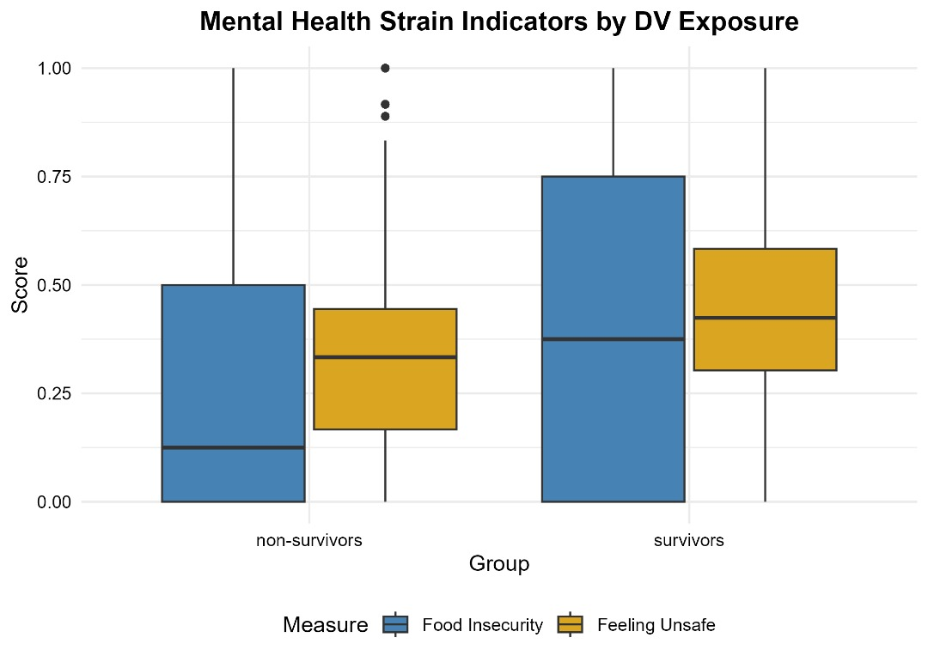
MENTAL HEALTH STRAIN INDICATOR BY DV EXPOSURE

Slide 23
Feelings of Safety
Increased Feelings of Unsafety:
Women exposed to domestic violence report feeling unsafe walking alone during both day and night.
This heightened sense of insecurity is a significant mental health strain indicator, affecting their overall well-being and daily functioning.
Conclusion
The evidence strongly supports that women exposed to domestic violence experience higher levels of food insecurity and feelings of unsafety, which are critical indicators of mental health strain. Addressing these issues is essential for improving the overall health and safety of survivors.

Slide 24
SUMMARY OF FINDINGS:
High prevalence of DV among women.
Significant relationships between DV exposure and safety perceptions, mental health, and help-seeking behavior.
Women with disabilities are at a higher risk of experiencing DV.

Slide 25
RECOMMENDATION
Policy Implications:
Increase awareness and support for women experiencing DV.
Enhance access to resources for women with disabilities.
Promote education on domestic violence and its impacts.

